Slide 1
Singapore resale price prediction
Created by – Aastha mukherjee

Slide 2
Agenda
Problem Statement and Motivation
Data Collection
Business Benefit
Data Preprocessing and Feature Engineering
EDA
Model Creation
Summary

Slide 3
Problem statement
The objective of this project is to develop a machine learning model and deploy it as a user-friendly web application that predicts the resale prices of flats in Singapore. This predictive model will be based on historical data of resale flat transactions, and it aims to assist both potential buyers and sellers in estimating the resale value of a flat.
MOTIVAtION
The resale flat market in Singapore is highly competitive, and it can be challenging to accurately estimate the resale value of a flat. There are many factors that can affect resale prices, such as location, flat type, floor area, and lease duration. A predictive model can help to overcome these challenges by providing users with an estimated resale price based on these factors.

Slide 4
DATA collection

Slide 5
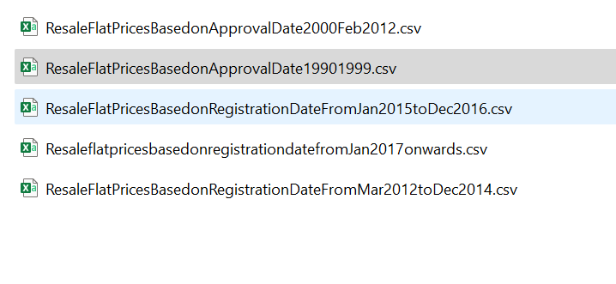
1. Data is collected from the site provided by Singapore Govt. that holds the data about the different HDB(Housing and Development Board ) Flats for the years 1990 to Till Date
2. There were 5 such csv files, so first of all, the csv files are collated into one file so that data preprocessing and cleaning can happen.
3. Site to download the files :
https://beta.data.gov.sg/collections/189/view

Slide 6
BUSINESS BENEFIT

Slide 7
1. Business depends on various factors :
- Customer satisfaction
- Fulfilling customer needs
- Eye-catching offers
- Additional benefits that are not being offered by other competitors
2. Here, we are concentrating on resale of the HDB Flats in future. For these, businesses need to understand the ways that will in turn benefit the customer and producing greater profits.
3. So, in this project, we have taken into consideration about the flats that are nearest to the MRT stations need to be costly, because, the better the transportation system, better will be the customer satisfaction. So, prices will be more in those regions rather than those which are far away from the MRT ( Mass Rapid Transit ) station.
4. Similarly, the flats which are closer to CBD( Central Business District ) in Singapore, are supposed to be costlier than those which are far away.
5. For this reason, in this project, we have taken into consideration of these distances and added them as additional feature to our dataset.

Slide 8
6. This is applicable for HDB Flats for Singapore only :
In Singapore, more than 75% of the land belongs to Singapore Land Authority (STA), while the remaining freehold land belongs to statutory boards like HDB, JTC, PSA and other private owners.
Before you assume that every house in Singapore is on a 99-year lease and start panicking about the impending expiry date, it’s important to be very clear on your property’s leasehold type. There are three leasehold types: 99-year lease, 999-year lease and freehold.
All HDB flats have a 99-year lease, while private properties are available in all three leasehold types. However, the government has stopped providing 999-year leases and hence the most common lease type is the 99-year lease. Since 999 years is a long time, houses with a 999-year lease or freehold lease are highly sought after.
So, Real Estate Agents and Brokers must be aware of the existing Govt. Policies and Norms so that there is nothing illegal.

Slide 9
DATA PREPROCESSING & FEATURE ENGINEERING

Slide 10
Steps Followed :
1. Check the null values of each feature. We see that “remaining_lease” has 709050 null values, so we dropped them.
2. For predicting the resale price, we are counting on 2 more interesting features that are not included in the dataset. These are ( as described in “Business Benefit” slide ) :
a) nearest distance of these flats from MRT stations and
b) distance of the flat from CBD
3. New features are also created that will prove useful in prediction .
4. We are also performing Feature Engineering methods to select or neglect the features that we will use to create our ML model for predicting the resale price.
5. The data is also cleaned up to remove skewness and outliers that will help in successful prediction.
6. We are going to find the correlation using heatmap method to see which feature(s) turn out to be rocking star for the resale price prediction.

Slide 11
Features taken into consideration :
Features | Description
1. address | Created a new column using “block” and “street_name”, it denotes the address of each flat
2. min_dist_mrt | Feature showcasing the minimum distance of a HDB Flat address from the nearest MRT (Mass Rapid Transit) system
3. cbd_dist | Feature showcasing the distance of a HDB Flat address from the CBD(Central Business District) : main commercial city centre of Singapore
4. storey_range | Range of storeys appearing in this form Min TO Max, eg : 13 TO 15
5. storey_median | Median of storey range (range appears as MIN TO MAX )
6. lease_commence_date | The year when the lease for that flat has started
7. lease_remaining_years | No. of years remaining for the lease to complete [ Note : for Singapore, maximum lease can be of 99 years as per their new govt. policy )

Slide 12
Features taken into consideration :
Features | Description
8. flat_type | Type of flat, eg : 1 ROOM , 3 ROOM, Executive etc.
9. flat_model | Represents the model, eg : Improved, Simplified etc.
10. Town | Name of the town where flat is located
11. flat_type_encoded | Using Label Encoder created a new column out of flat_type
12. flat_model_encoded | Using Ordinal Encoder created a new column out of flat_type
13. floor_area_sqm | Floor area of the flat in square metres
14. Latitude and longitude | Latitude and longitude values of each flat address obtained using OneMap API
15. Block | Block of the flat
16. Postal_code | Postal code of the flat address obtained using OneMap API
17. Road_name | Road name of that flat address obtained using OneMap API

Slide 13
NEW DATAFRAMES CREATED :
Dataframes | Changes made
1. mrt_loc | A dataframe containing mrt__names , latitude and longitude
2. df_coordinates | A dataframe containing address(created in above table) , latitude and longitude’,’block_no’,'road_name’,'postal_code’,'address'
3. final_data | Containing the final rows required to predict the resale price

Slide 14
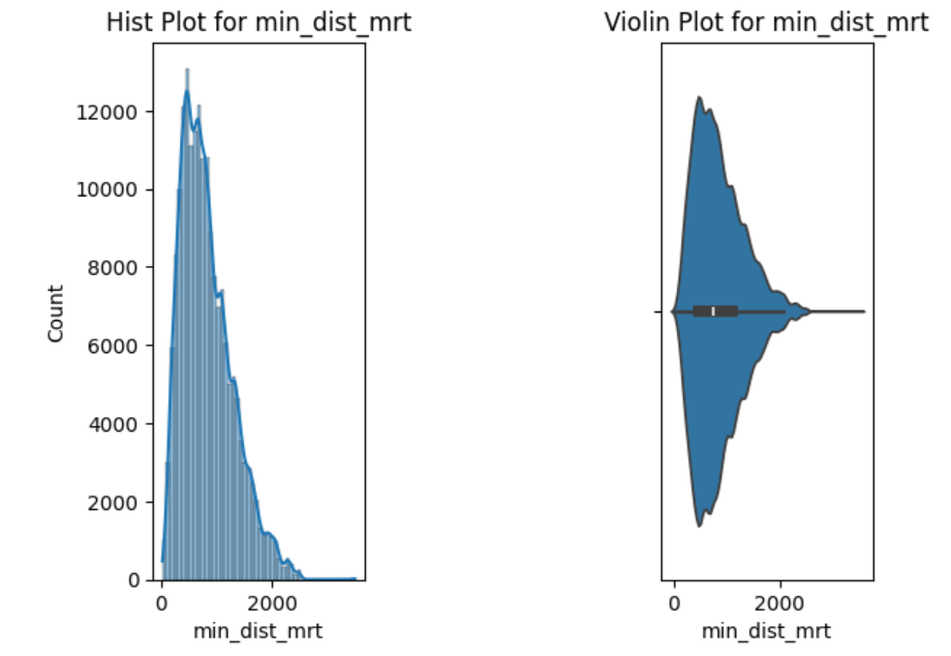
Handling Skewness
- Skewness of data is detected using HistPlot and Violin Plot.
- We found that the following features had skewed data so they were handled using Log Transformation method :
1. floor_area_sqm
2. lease_remaining_years
3. cbd_dist
4. min_dist_mrt
5. storey_median
6. resale_price

Slide 15
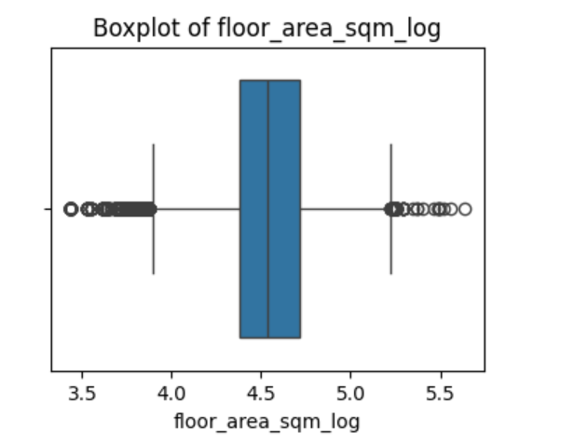
Handling OUTLIERS
- Outliers from the features are detected through Box Plot.
- We found that the following features had outliers so they were handled using IQR method :
1. floor_area_sqm_log
2. lease_remaining_years_log
3. cbd_dist_log
4. min_dist_mrt_log
5. storey_median_log
6. resale_price_log

Slide 16
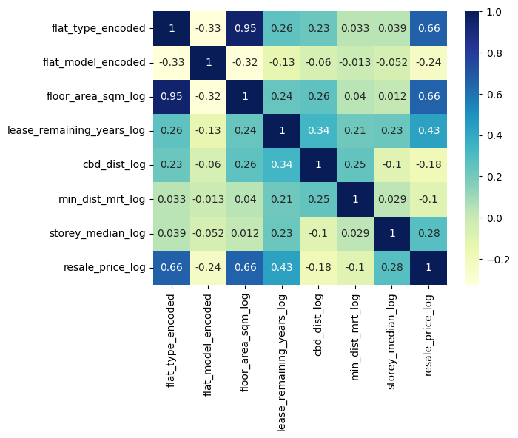
DETECTING THE CORRELATION :
From this Heatmap, we draw the following conclusions :
- floor_area : exhibits the most significant correlation with the resale price, since this correlation is somewhat positive.
- flat_type : also has significant impact on resale price since, it is also having similar correlation like floor_area
- flat_model : weakest negative correlation with the resale price, indicating that it has the lowest influence.
- cbd_dist and min_dist_mrt : has negative correlation so lower influence over the resale price.
- Irrespective of the nature of the association, whether positive or negative, the remaining factors that influence the resale price exhibit a modest level of strength.

Slide 17
FEATURE ENGINEERING

Slide 18
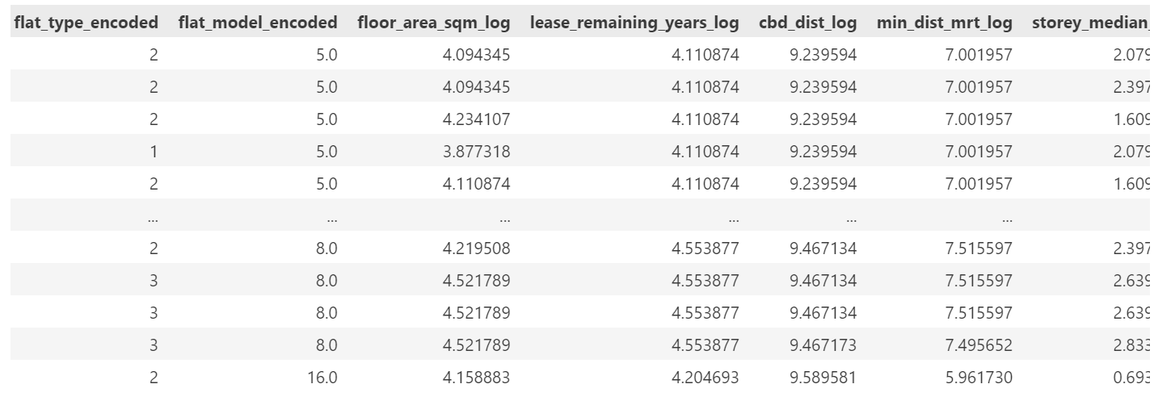
Selecting the features :
Since our model can understand only numerical data, we are selecting the data that are numerical. Hence the features selected are :
1. flat_type_encoded 5. cbd_dist_log
2. flat_model_encoded 6. min_dist_mrt_log
3. floor_area_sqm_log 7. storey_median_log
4. lease_remaining_years_log

Slide 19
EDA

Slide 20
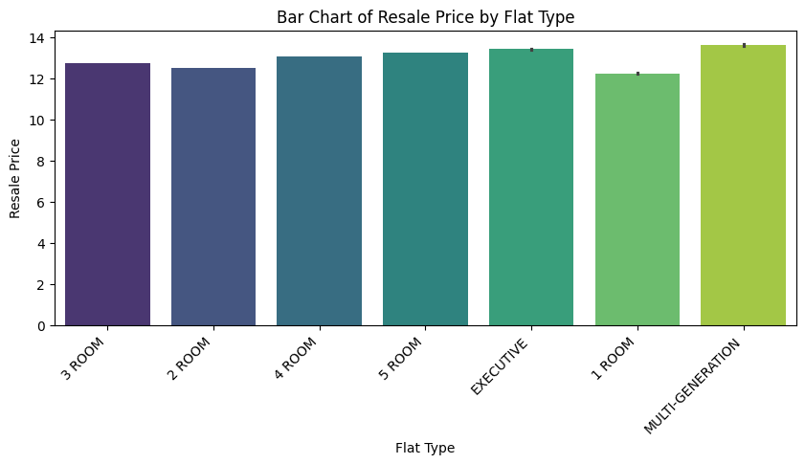
Relation between Flat_type Vs RESALE PRICE

Slide 21
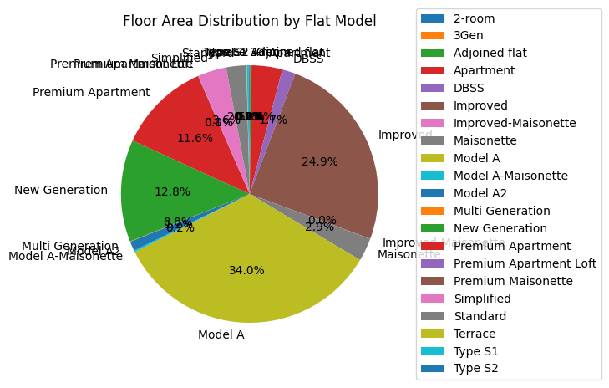
PIE CHART SHOWING FLOOR_AREA DISTRIBUTION FOR EACH FLAT_MODEL ->

Slide 22
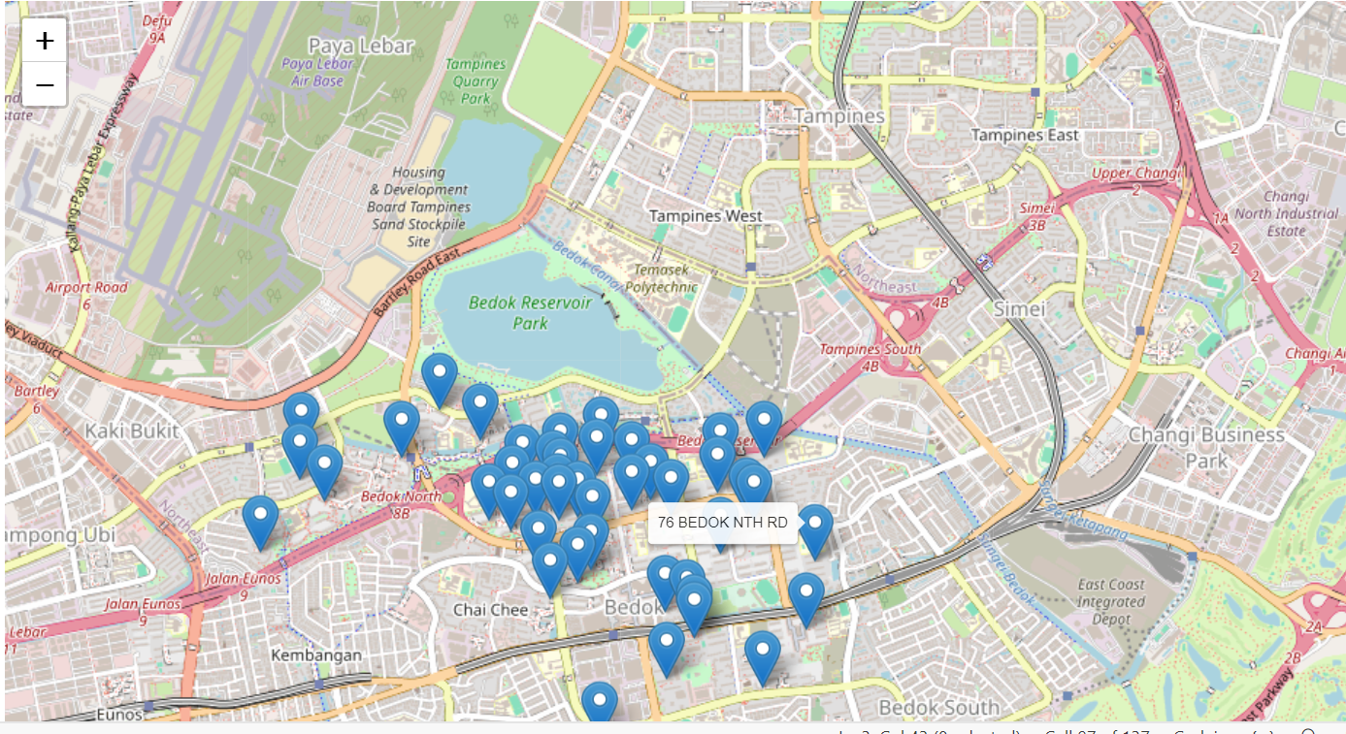
FOLIUM MAP SHOWING THE FLAT LOCATIONS

Slide 23
MODEL CREATION

Slide 24
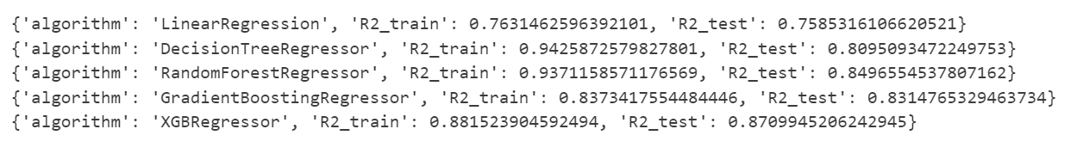
Steps FOLLOWED :
First of all, we have checked which model will suit best to predict the price. So, we found out the accuracy score of each model as follows:
2. We saw that, DecisionTreeRegressor proved to be accurate for this. So, we have used “Decision Tree Regressor” regression model to predict the resale price.
3. However, the values are too accurate, so we have to use cross-validation function to protect against overfitting in a predictive model, particularly in a case where the amount of data may be limited.
4. Finally the model is trained on training_Set and it is put to use.

Slide 25
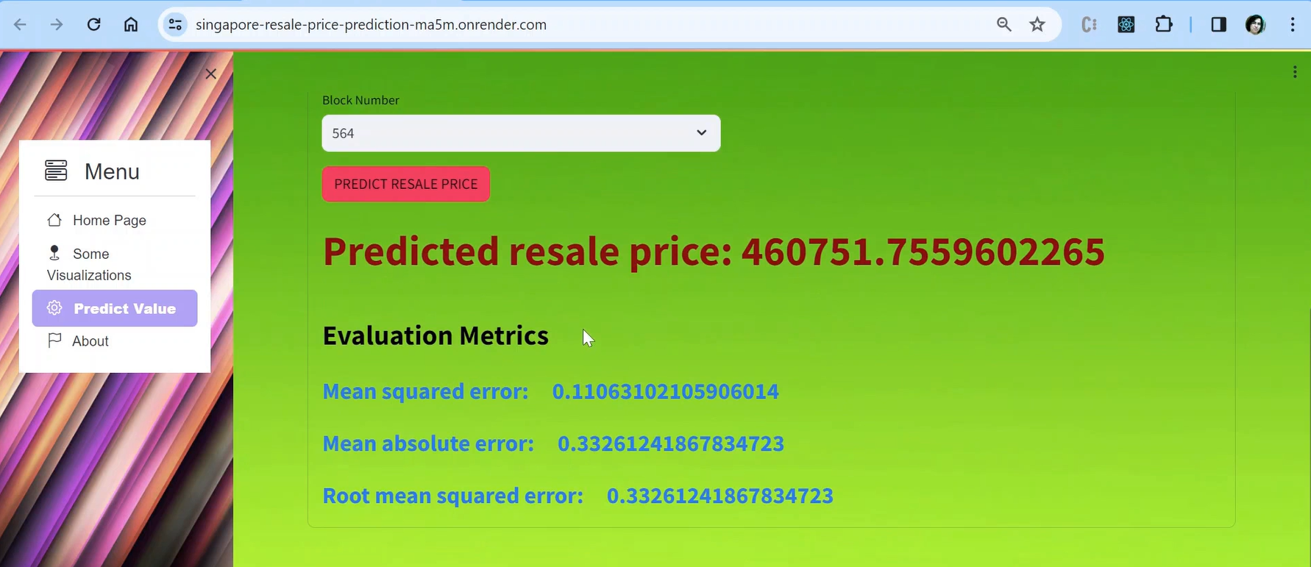
MODEL USED :

Slide 26
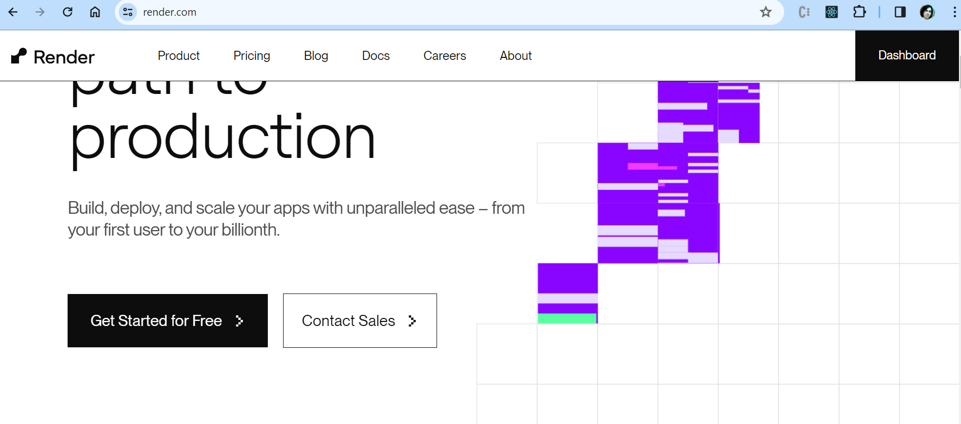
DEPLOYMENT PROCESS ON RENDER
First of all, open “Render” website. Link is given below :
https://render.com/
2. Now click on “Get Started for Free” as shown below :
3. Next, click on “New”-> Webservice button to deploy the webservice.

Slide 27
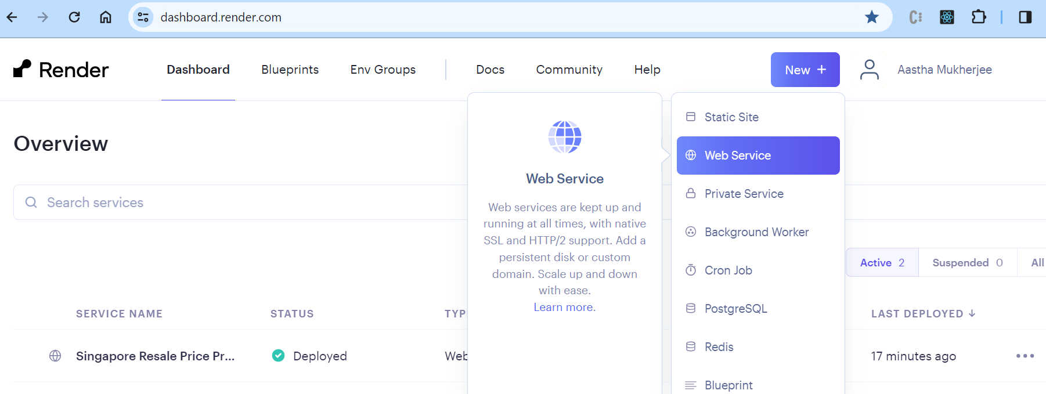
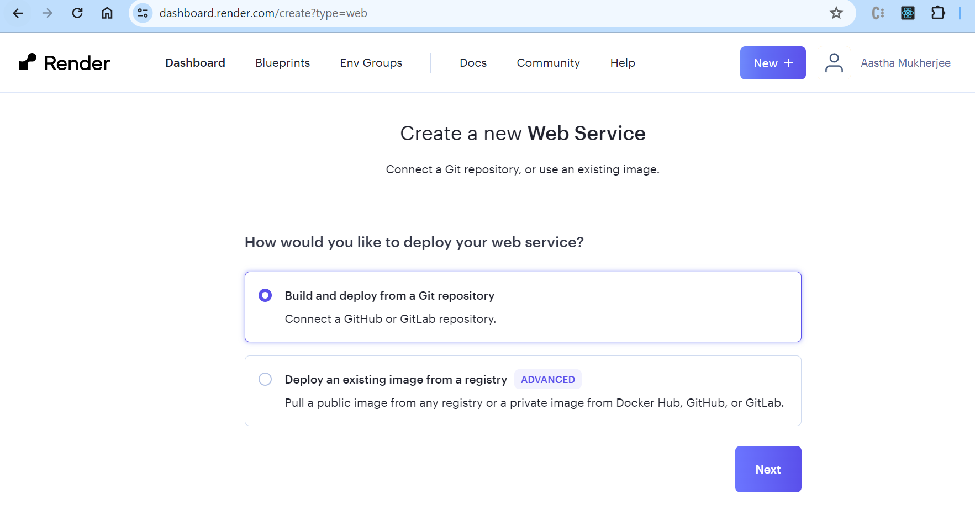
4. Next, choose “Build and deploy from Git Repository” and then click on “Next”.

Slide 28
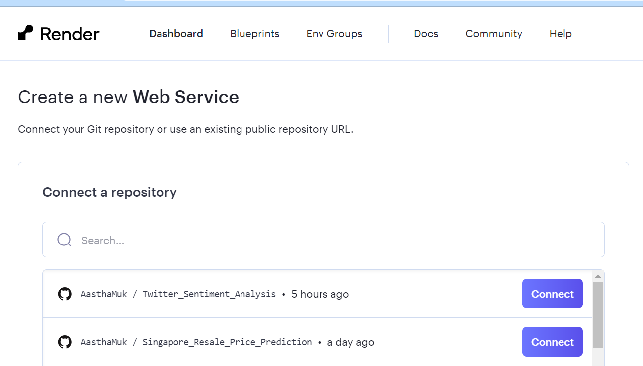

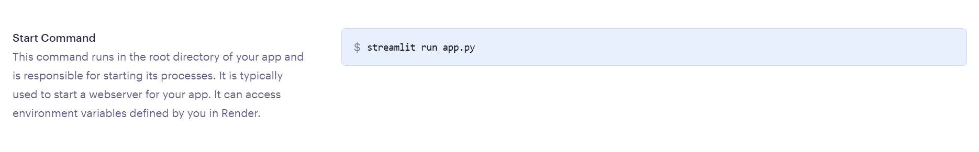
5. Choose the Repository you want to connect with
6. Give “Service Name” and “Start Coomand”, ensure that Instance Type selected is of type “Free”.
.

Slide 29
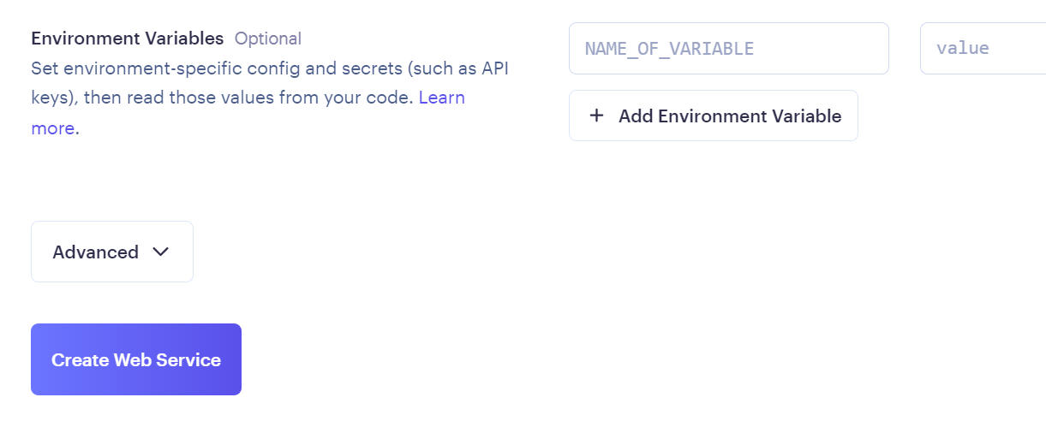
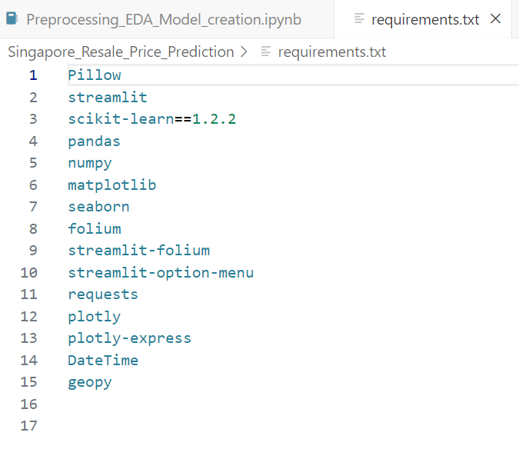
7. Finally click on “Create Web Service”.
8. Ensure that requirements.txt file is present in the git repo because the server cluster will install the required python libraries like this :

Slide 30
SUMMARY
This is how the features are extracted , and the model is built in order to predict the Resale Price.
Also, this document contains the preliminary steps required to deploy our application on the cloud so that it is accessible to any user on the internet.

